Slide 1
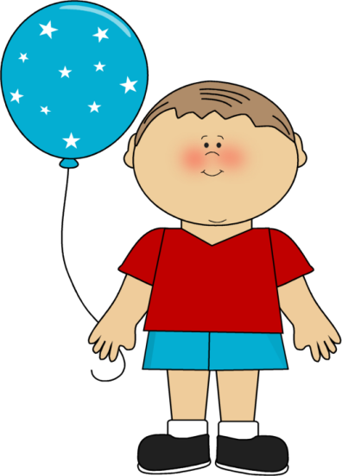
Πάμε παίξουμε;

Slide 2
0
1
2
3
4
Δείξε τον αριθμό που θα ακούσεις.
5
6
7
8
9
10
11
12
13
14
15
16
17
18
19
20

Slide 3
1 +1 =
3
2

Slide 4
2 +2 =
5
4

Slide 5
3 +3 =
6
7

Slide 6
4 +4 =
9
8

Slide 7
5 +5 =
11
10

Slide 8
6 +6 =
12
14

Slide 9
7 +7 =
17
14

Slide 10
8 +8 =
17
16

Slide 11
10 +10 =
20
21

Slide 12
5 +2 =
8
7

Slide 13
4 +0 =
0
4

Slide 14
4 +3 =
7
8

Slide 15
4 +2 =
3
6

Slide 16
7 +3 =
10
9

Slide 17
8 +2 =
10
11

Slide 18
15 +2 =
16
17

Slide 19
18 +2 =
19
20

Slide 20
14 +3 =
17
15

Slide 21
11 +3 =
13
14

Slide 22
10 +3 =
13
12

Slide 23
10 +8 =
17
18

Slide 24
10 +4 =
14
12

Slide 25
10 +2 =
12
13

Slide 26
10 +6 =
16
15

Slide 27
10 +1 =
11
12

Slide 28
5 +4 =
8
9

Slide 29
5 +3 =
8
7

Slide 30
13 +3 =
16
14

Slide 31
14 +4 =
17
18

Slide 32
12 +2 =
14
12

Slide 33
10 +0 =
10
0

Slide 34
8 +0 =
0
8

Slide 35
9 +0 =
0
9

Slide 36
14 +0 =
14
0

Slide 37
11 +0 =
0
11

Slide 38
11 +1 =
13
12

Slide 39
13 +1 =
12
14

Slide 40
19 +1 =
20
21

Slide 41
14 +1 =
15
16

Slide 42
17 +1 =
18
16

Slide 43
Είσαι αστέρι!

Slide 44
Μπράβο σου!!!!

Slide 45
Δεν πειράζει! Προσπάθησε ξανά!!!

